Slide 1
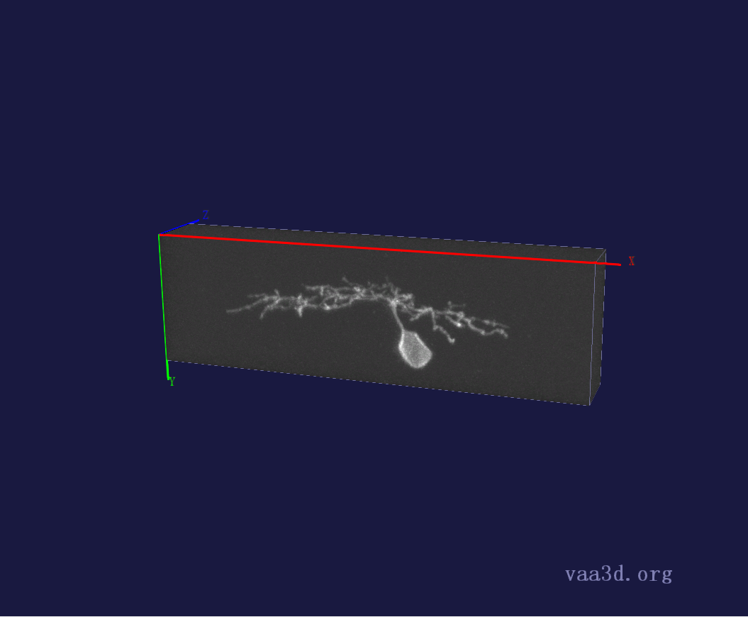
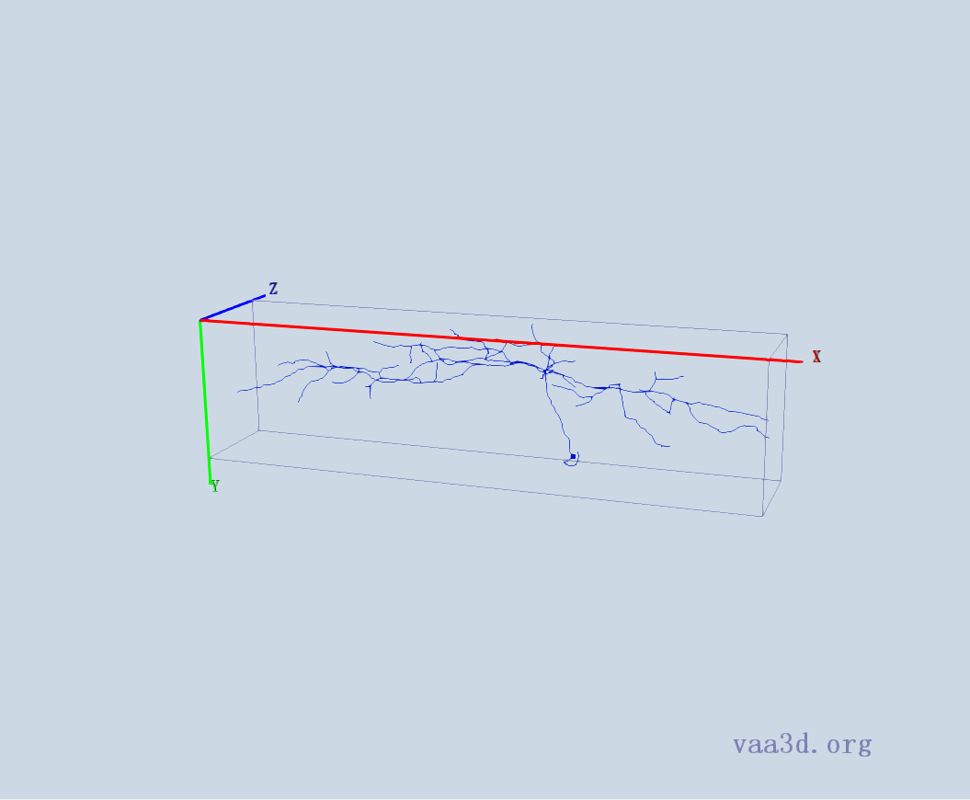
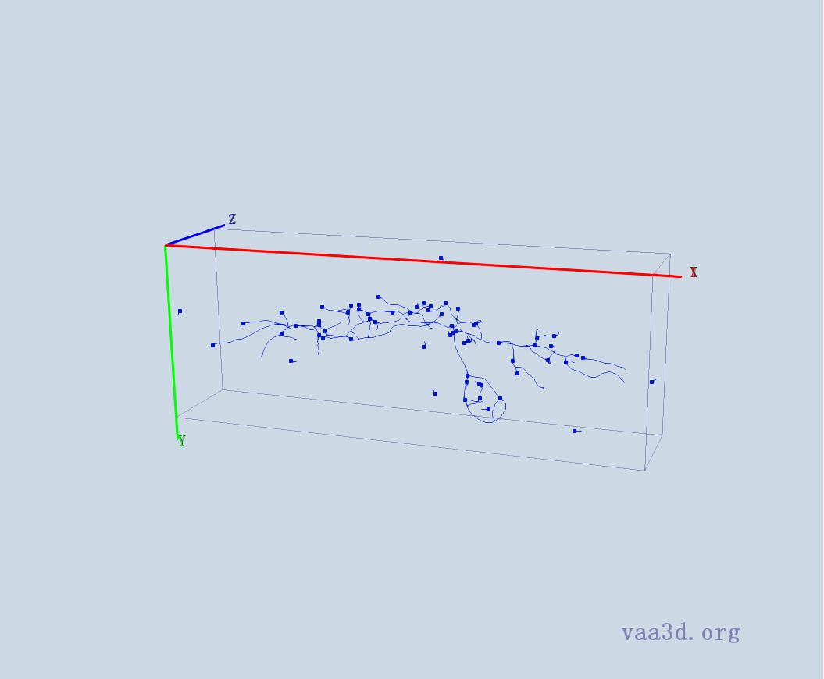
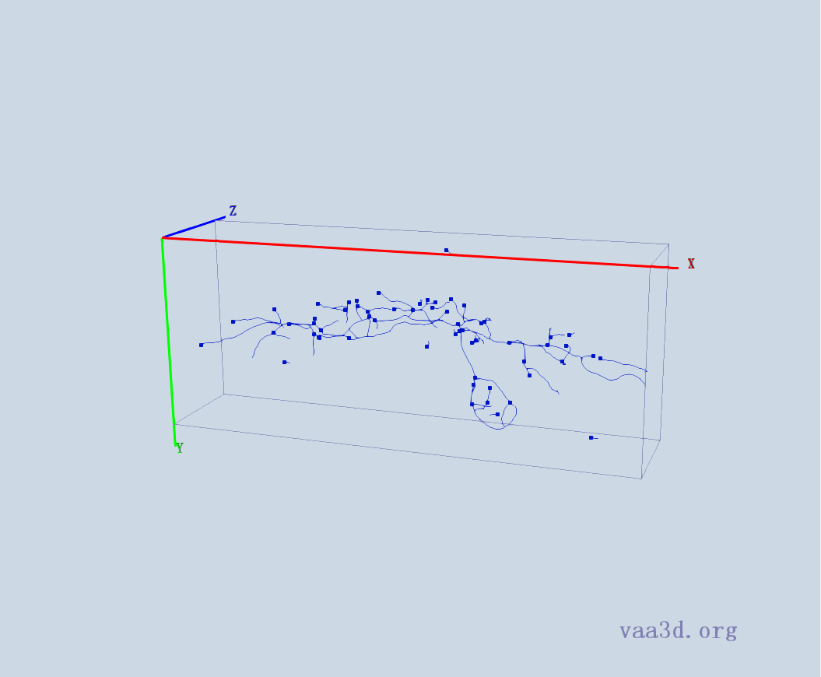
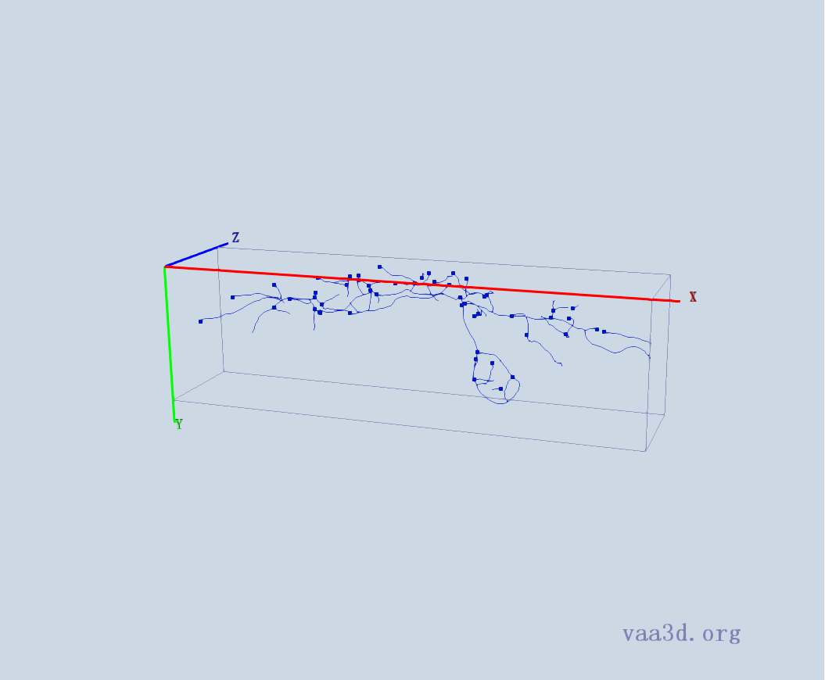
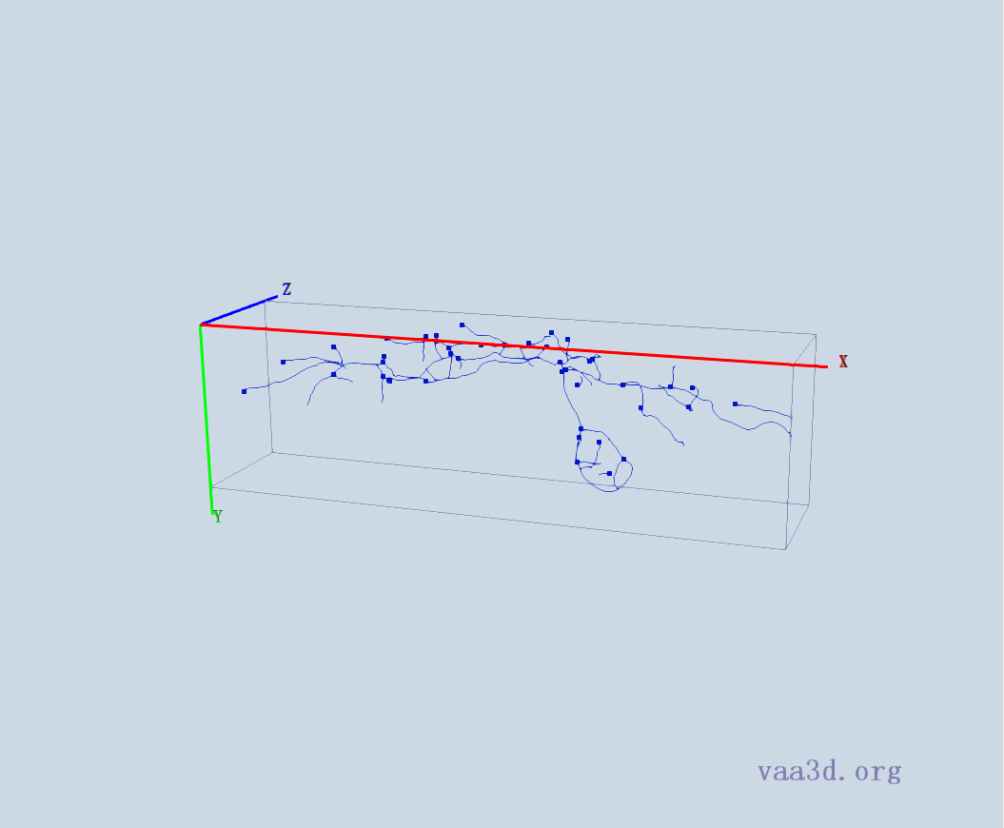
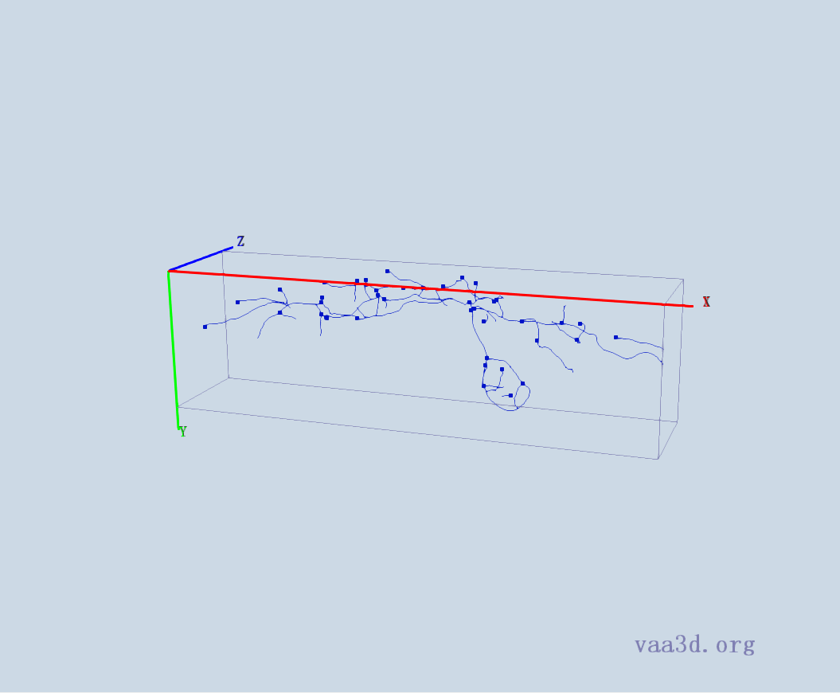
1_5dpf_Live_1-30-2010_12-39-26_PM_med_Red
GT
Thre=5 Thre=6 Thre=7
Thre=8 Thre=9

Slide 2
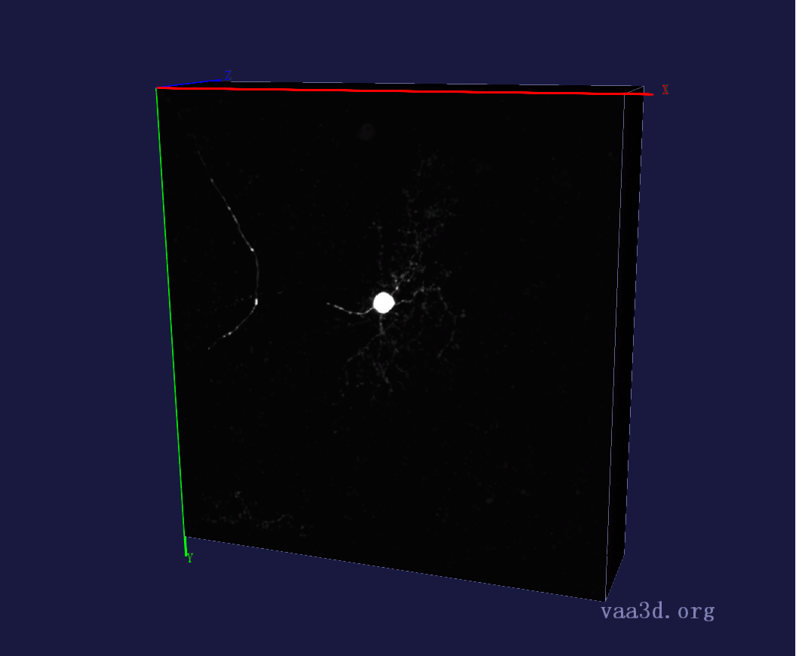
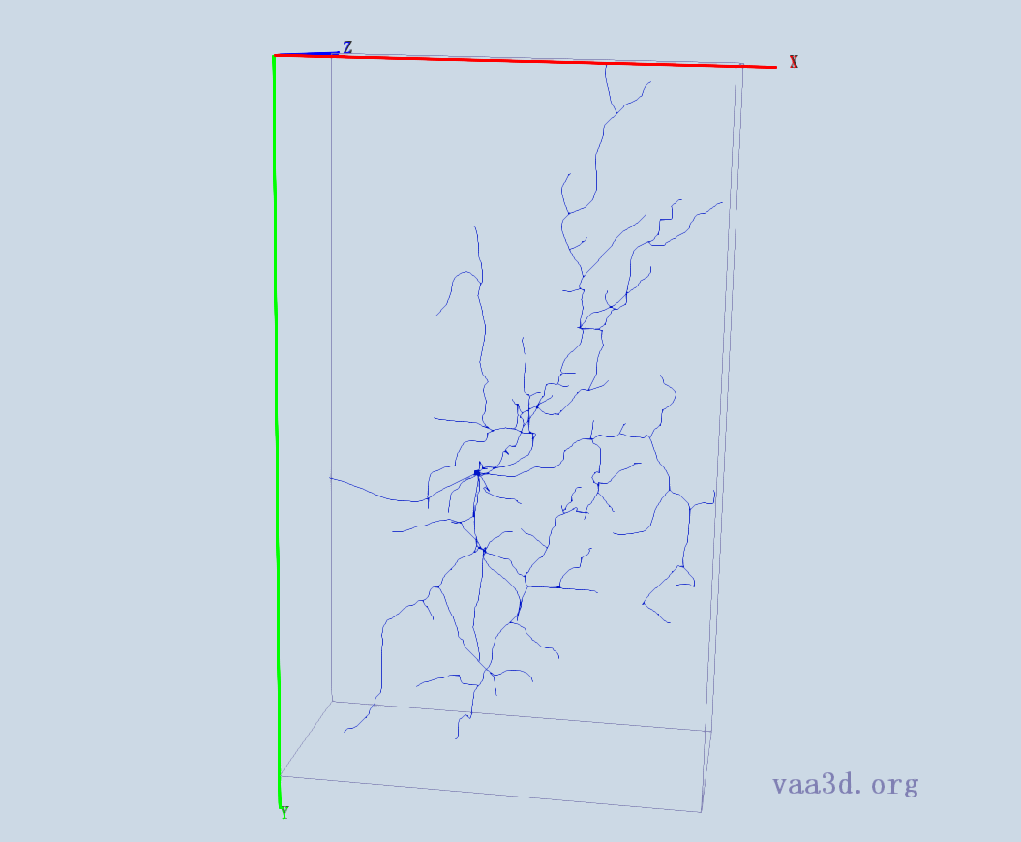
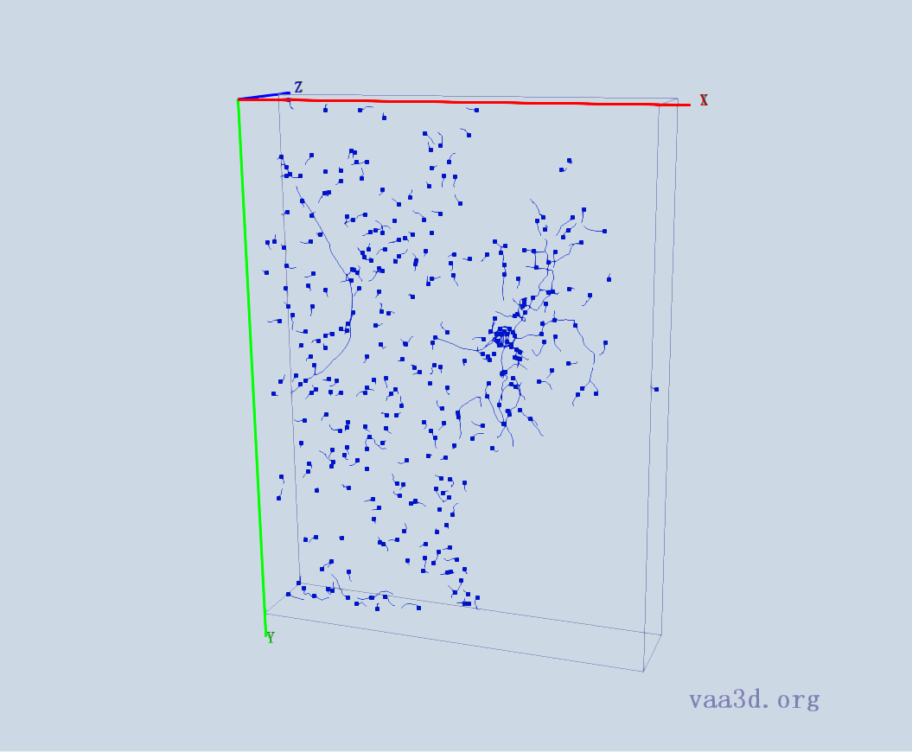
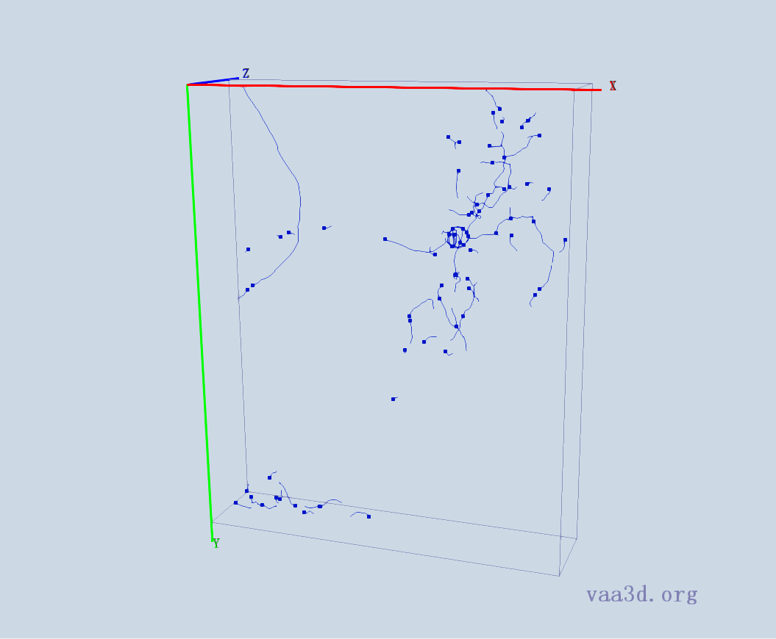
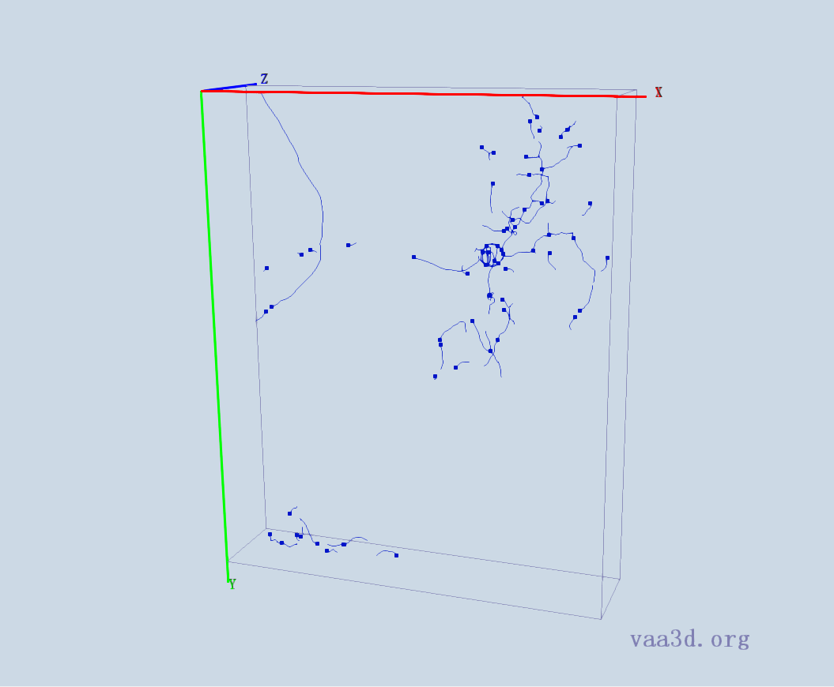
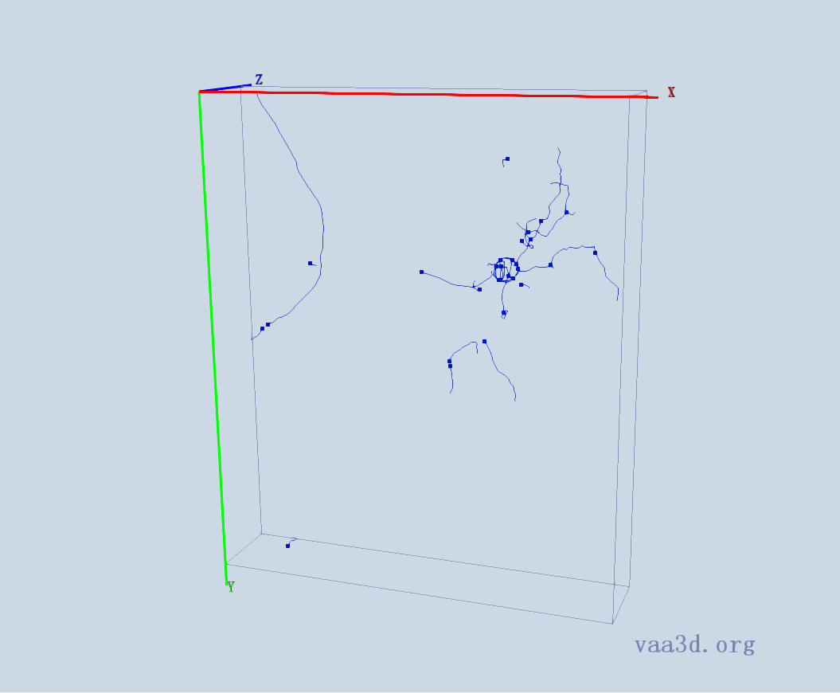
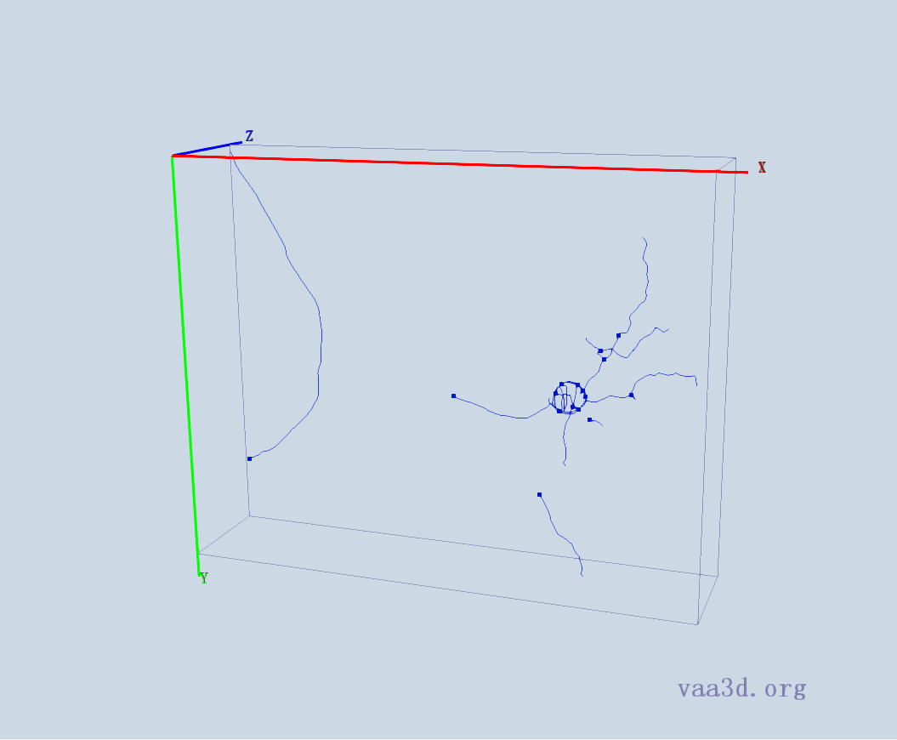
1_8_Ch2
GT
Thre=18 Thre=19 Thre=20
Thre=30 Thre=34

Slide 3
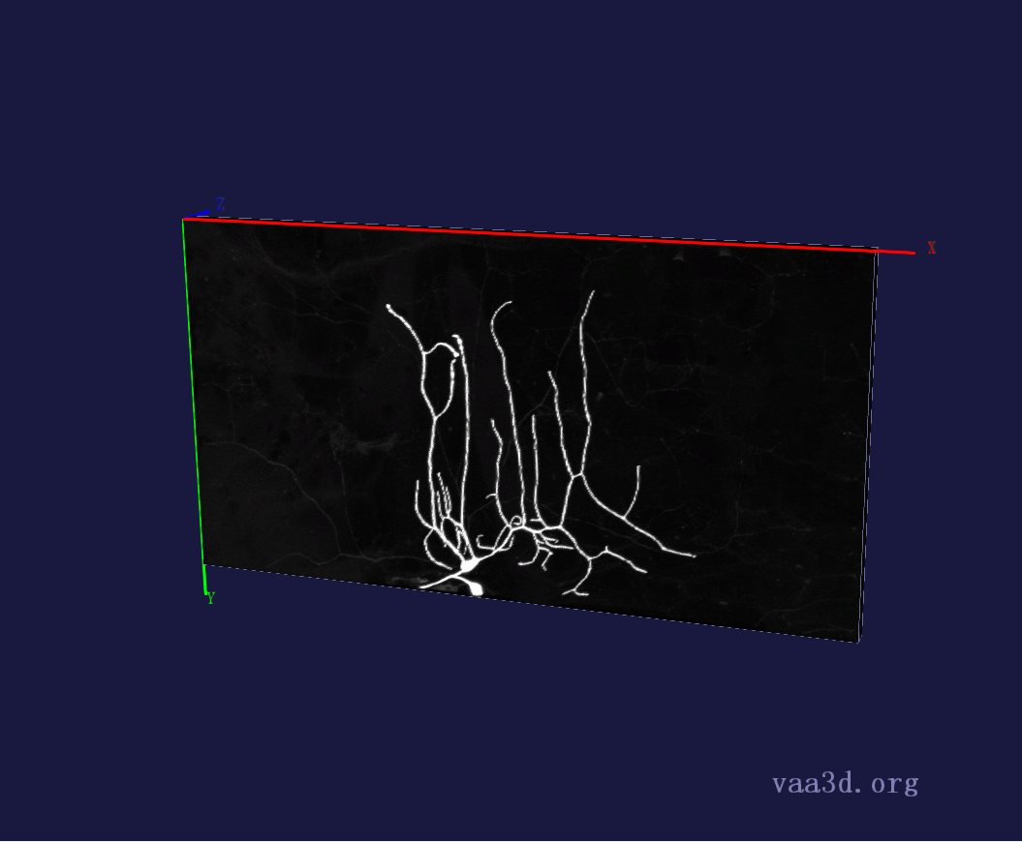
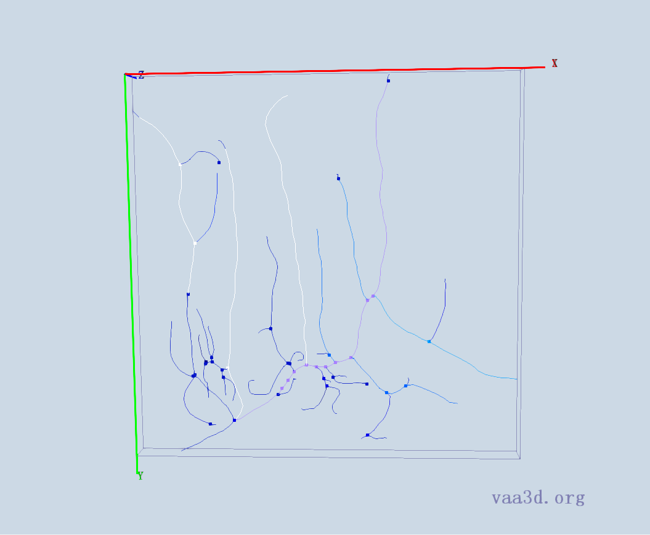
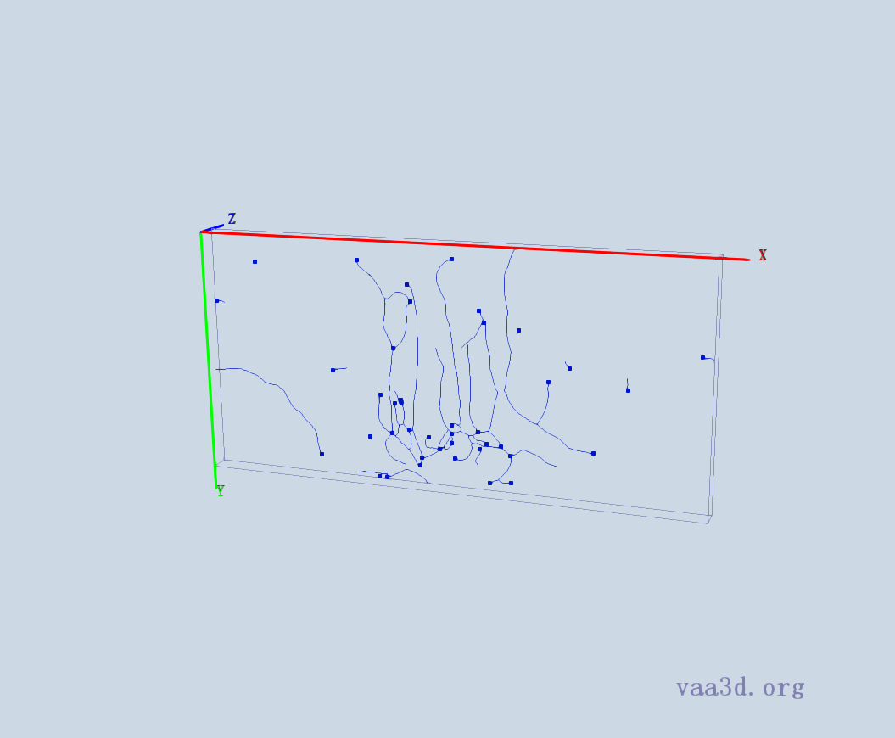
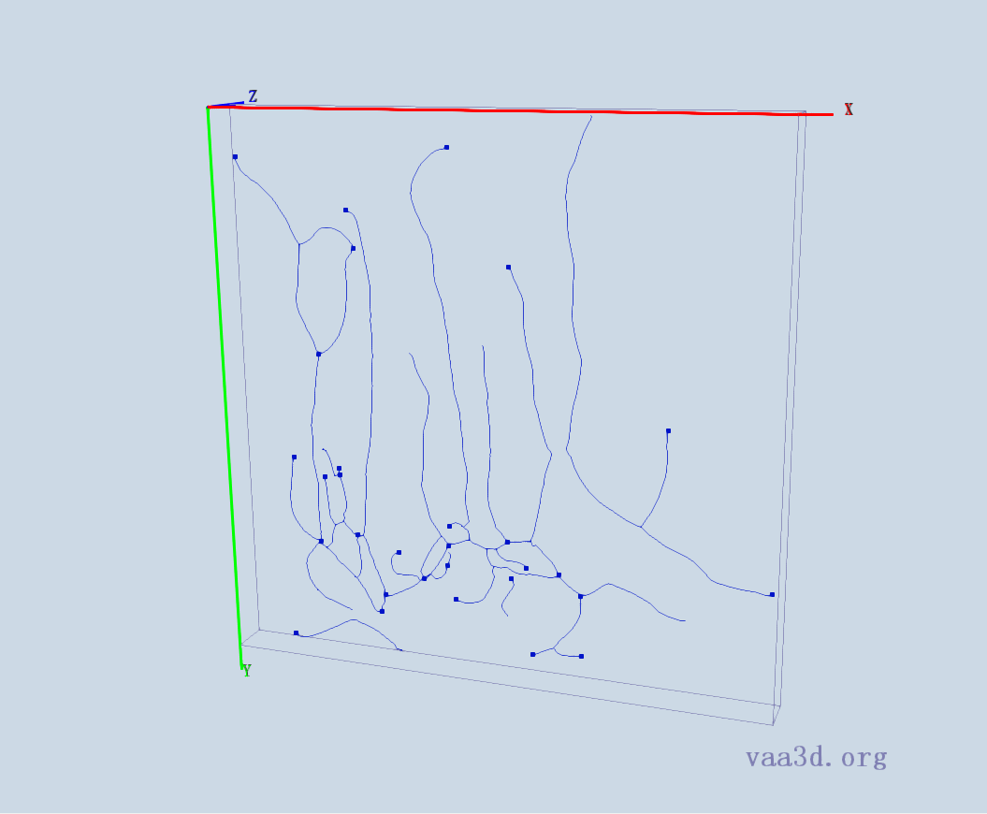
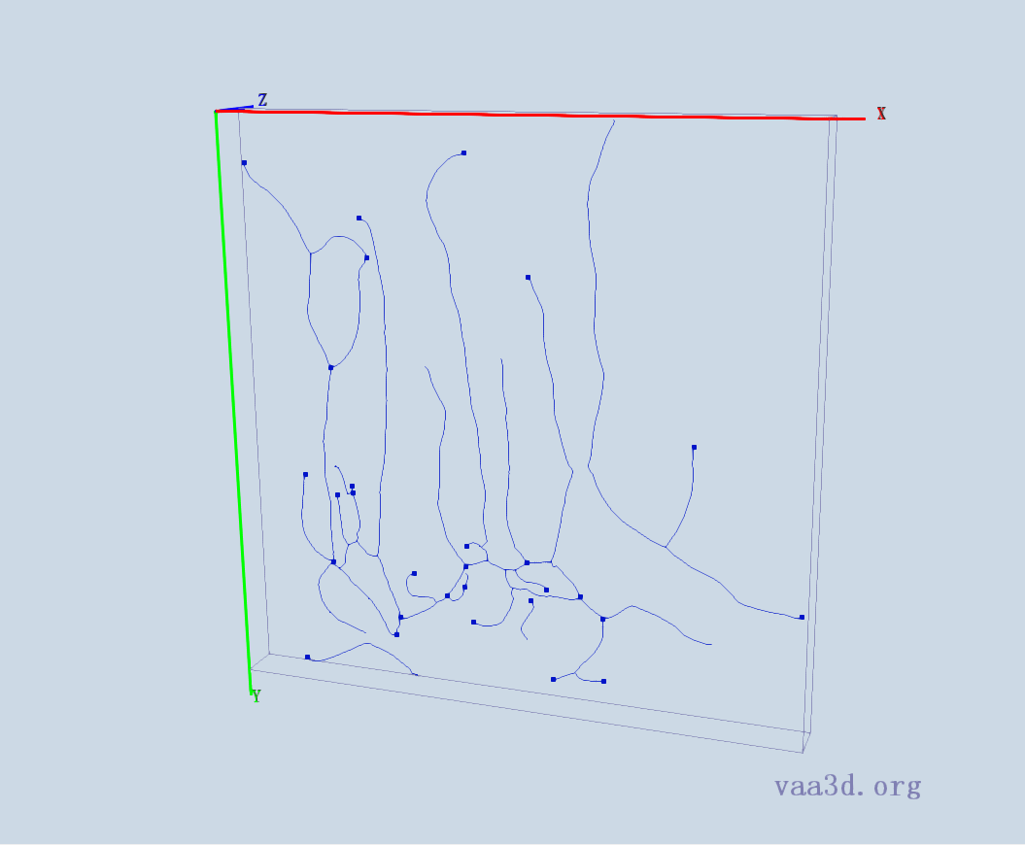
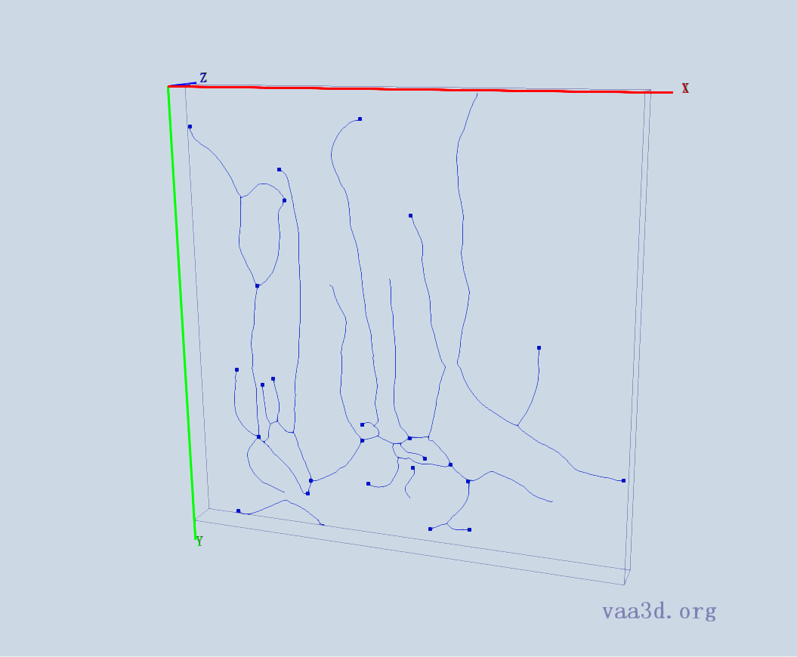
2_CL-I_Membrane-GFP_X_F-Actin-Red_ddaE
GT
Thre=22 Thre=23 Thre=24
Thre= 25 Thre=26

Slide 4
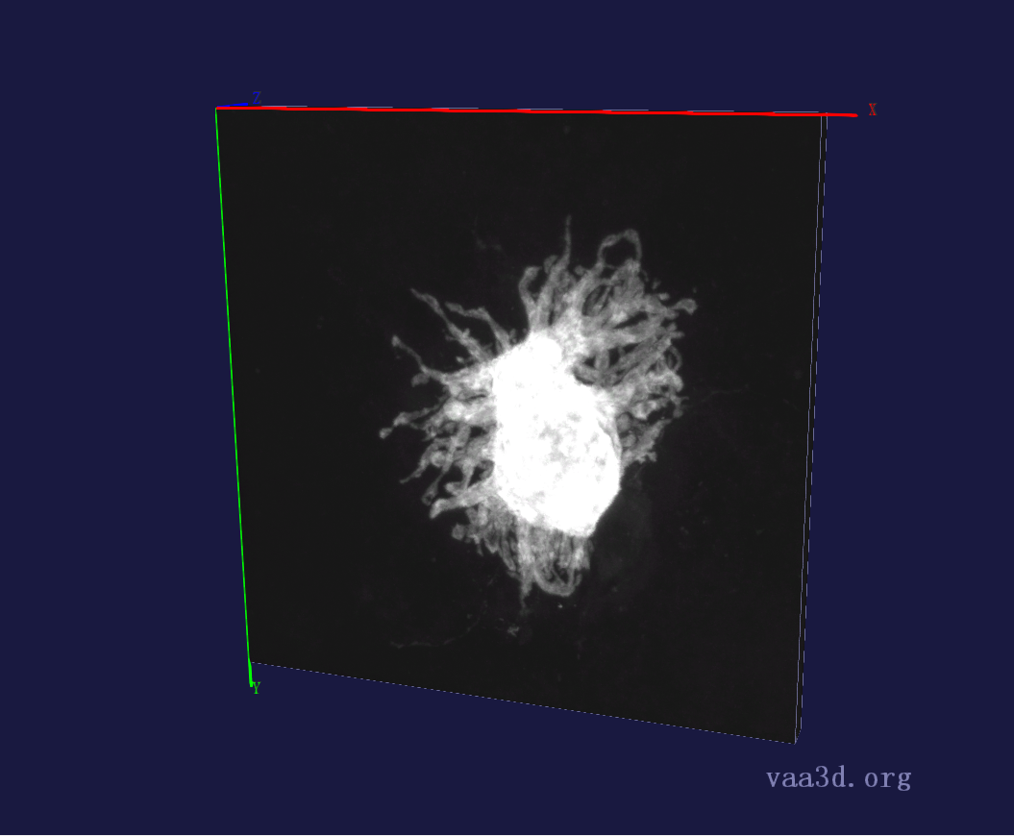
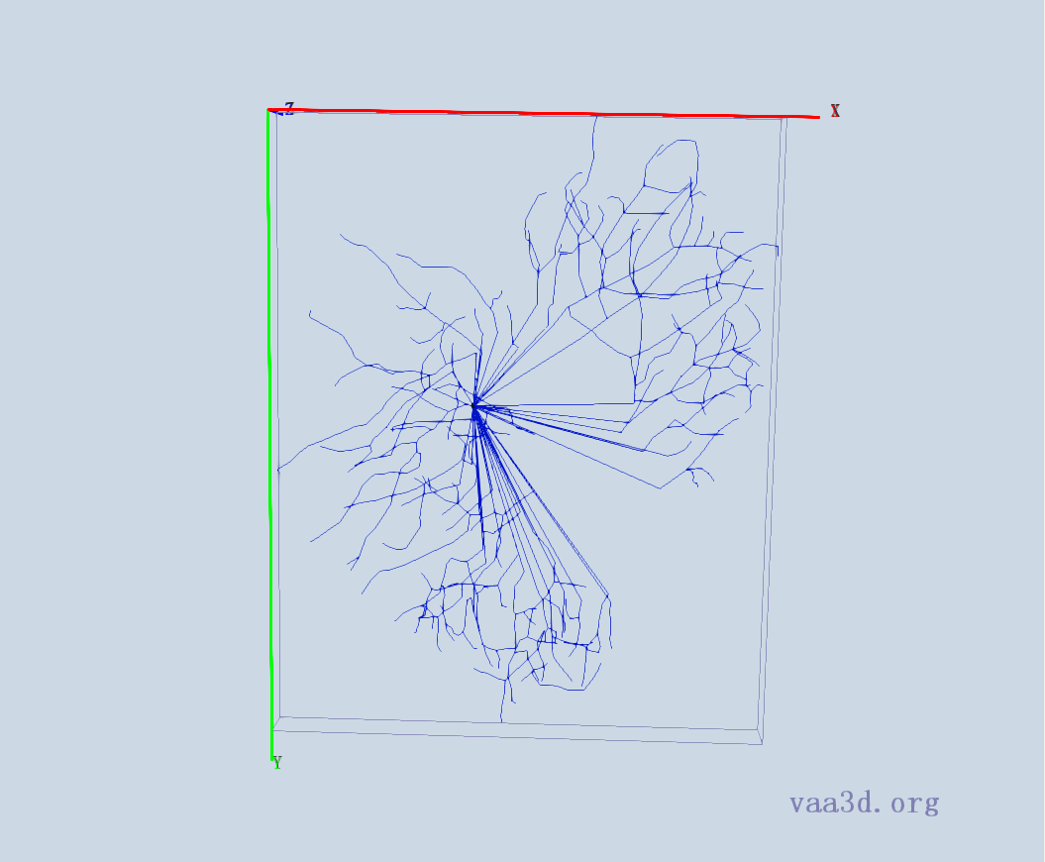
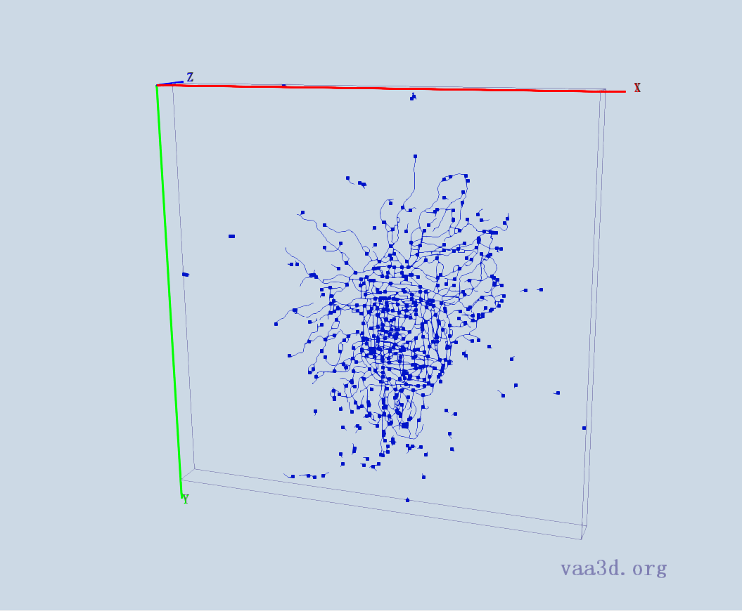
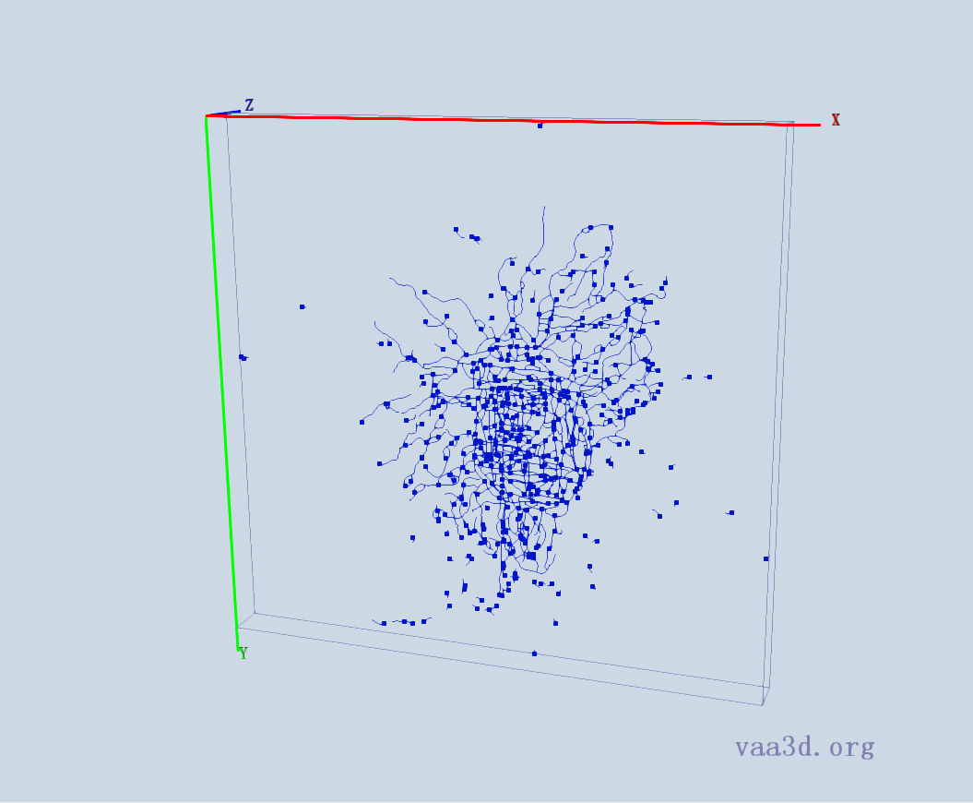
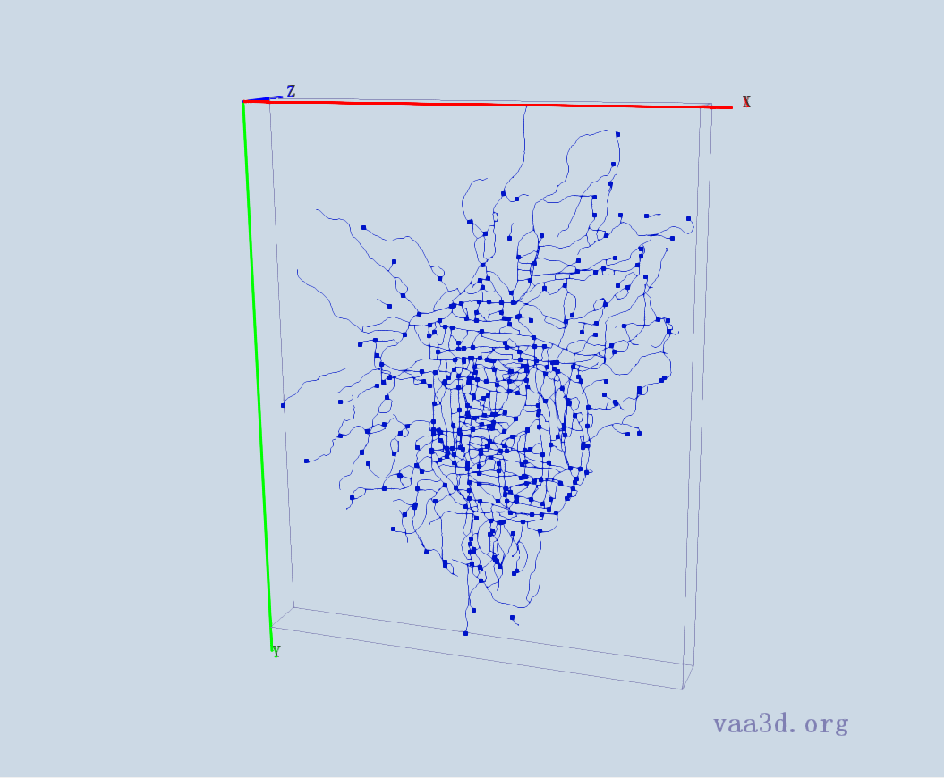
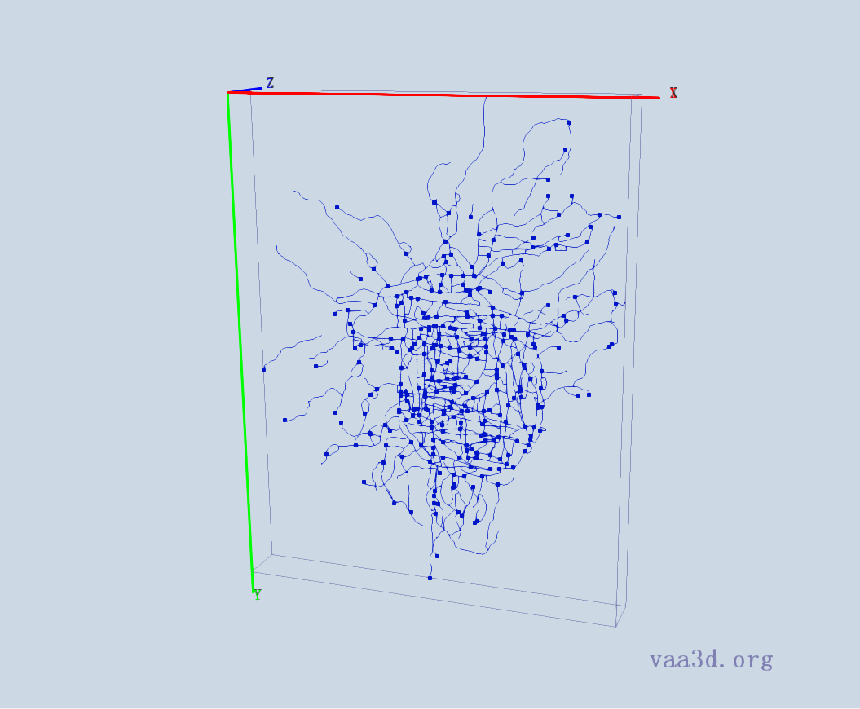
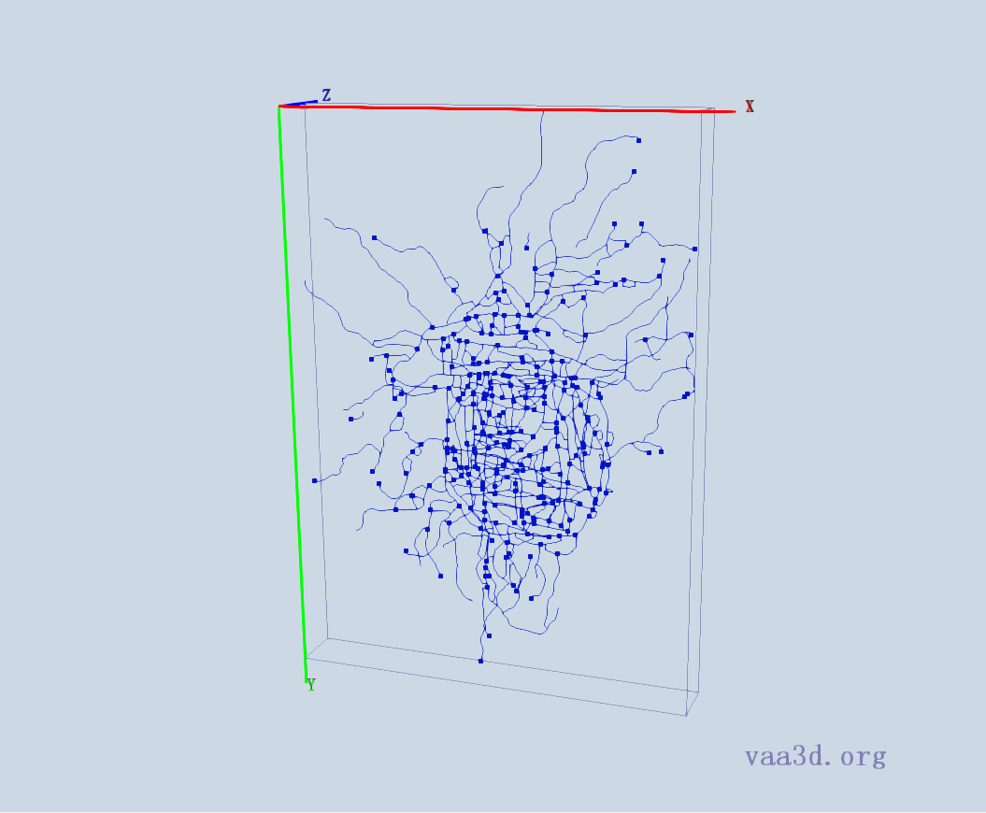
10-2909-s5-left-cell3_merge_c2
GT
Thre= 2 Thre= 3 Thre=4
Thre= 5 Thre= 6

Slide 5
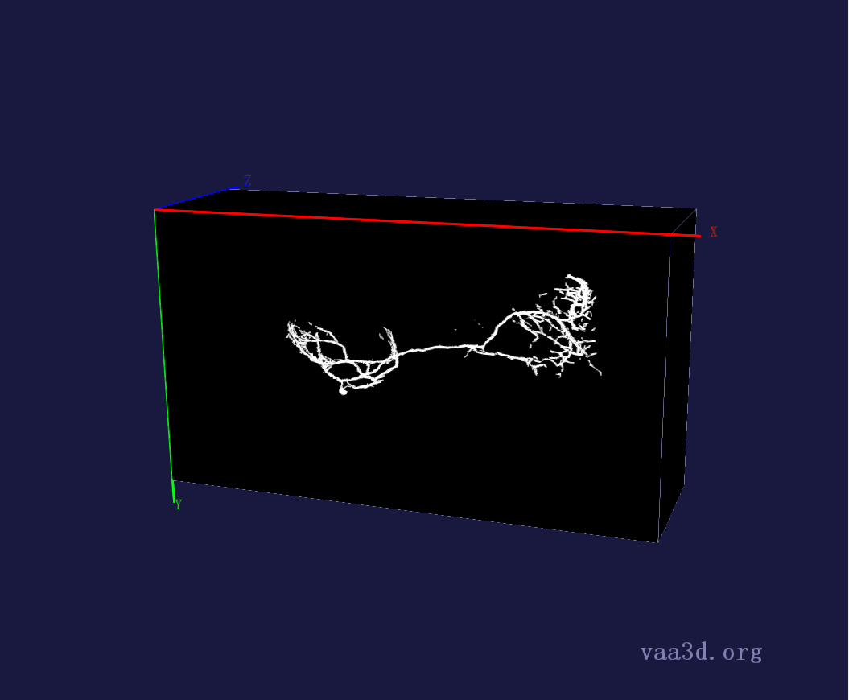
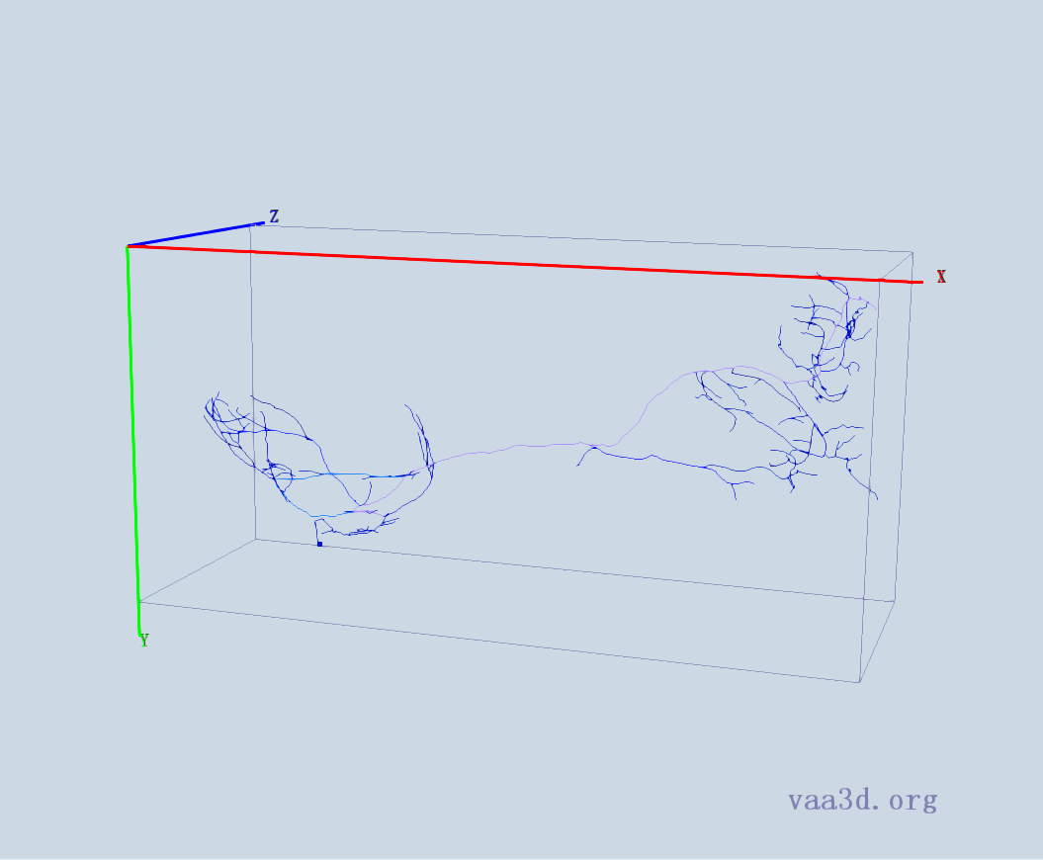
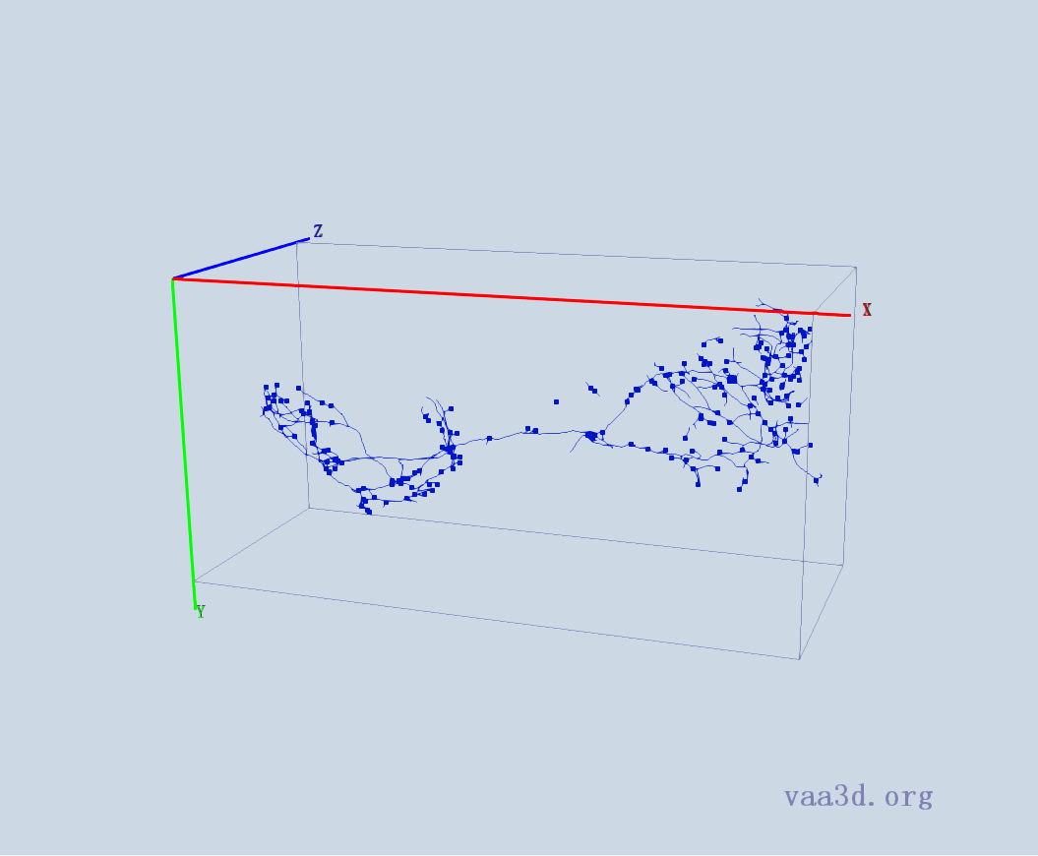
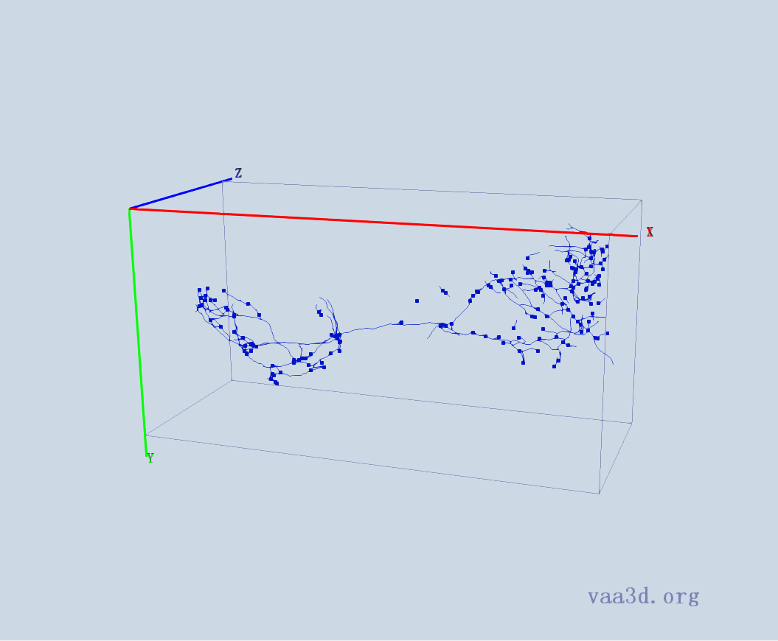
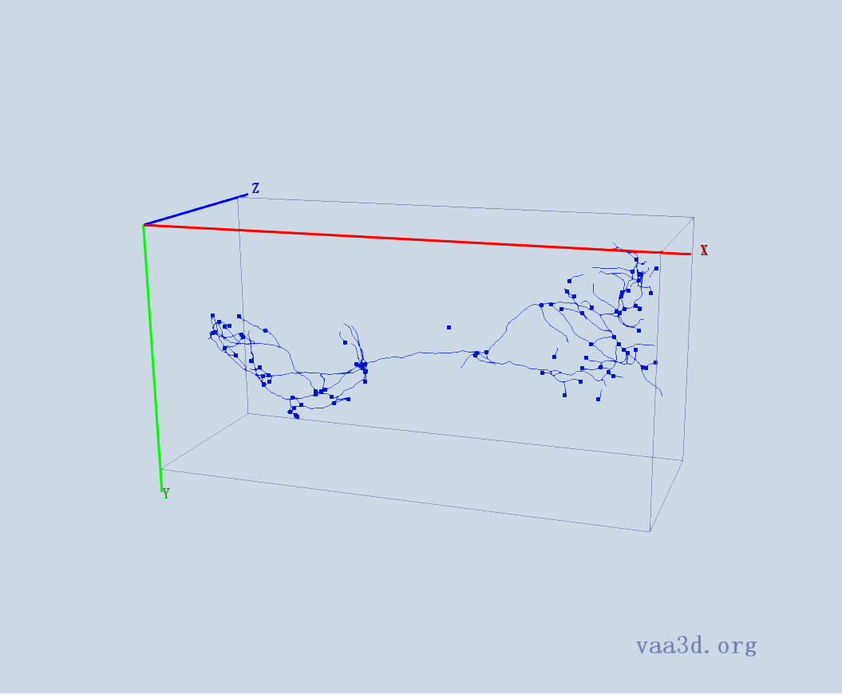
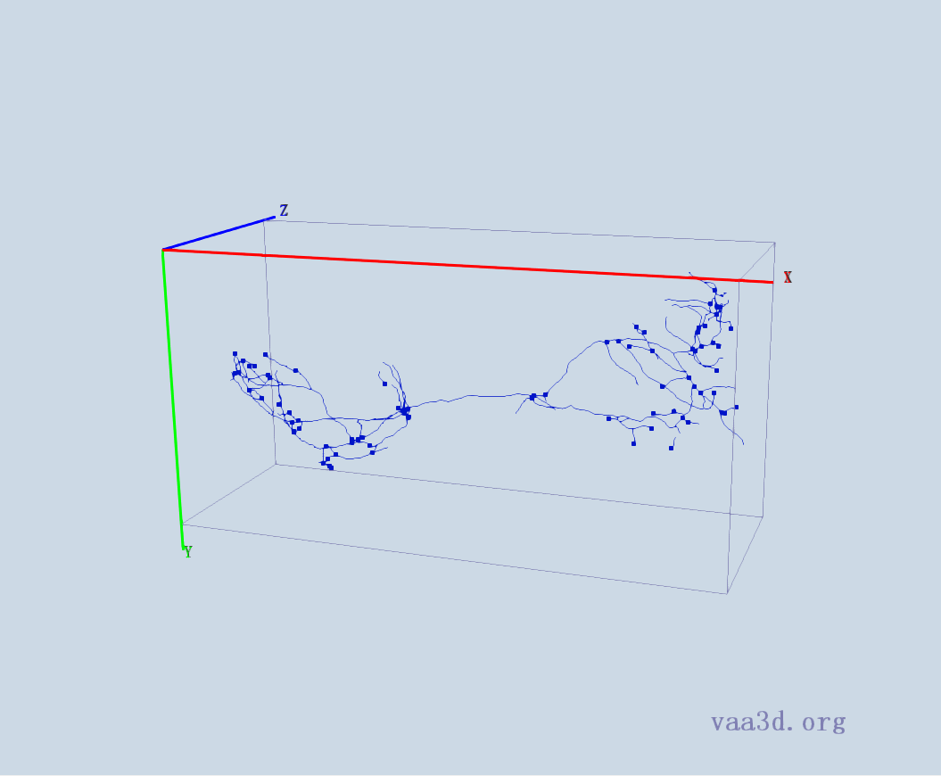
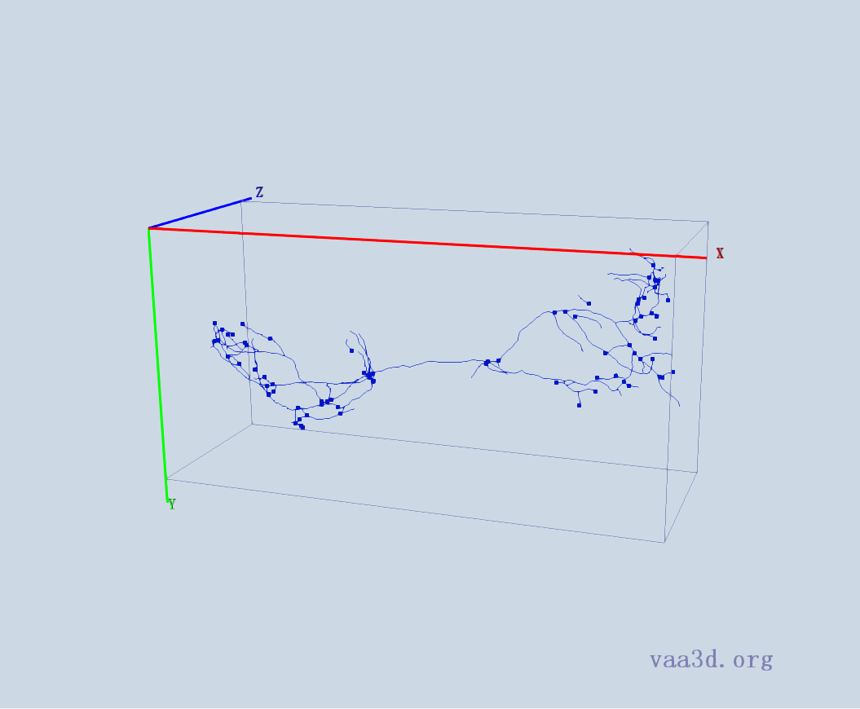
0664_seg
GT
Thre=1 Thre=2 Thre=3
Thre=4 Thre=5

Slide 6
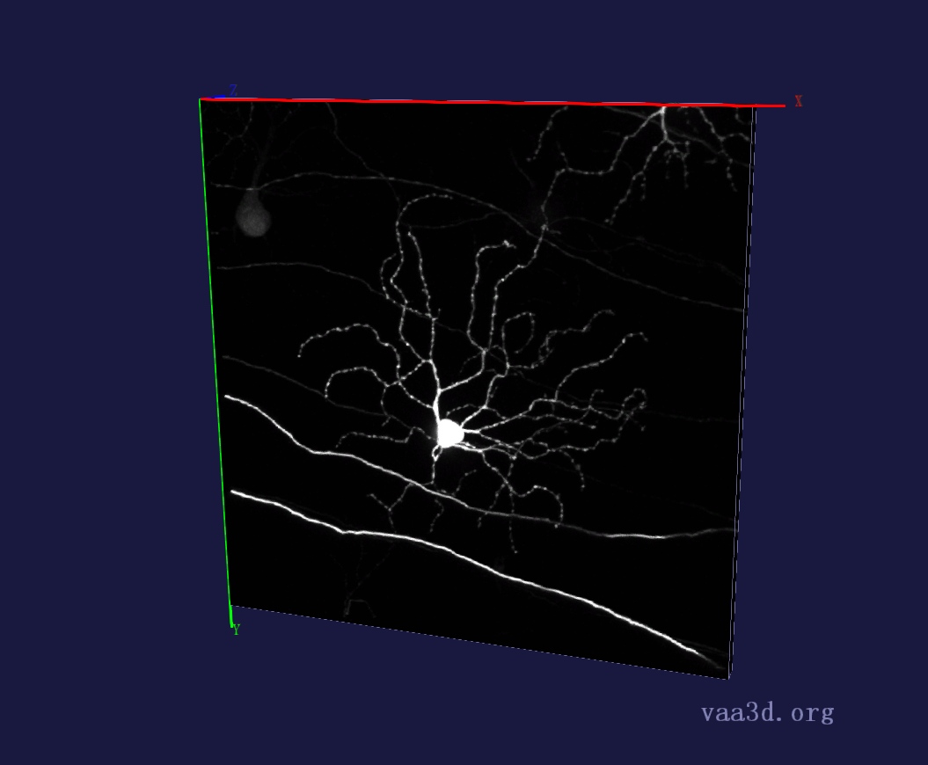
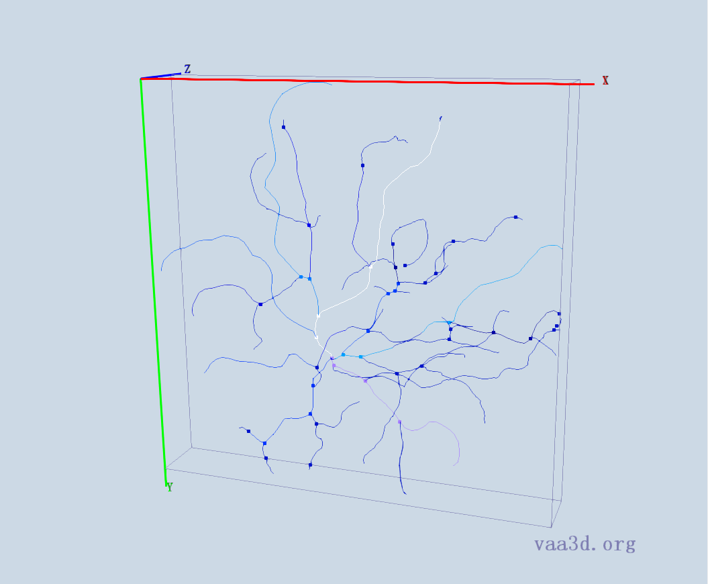
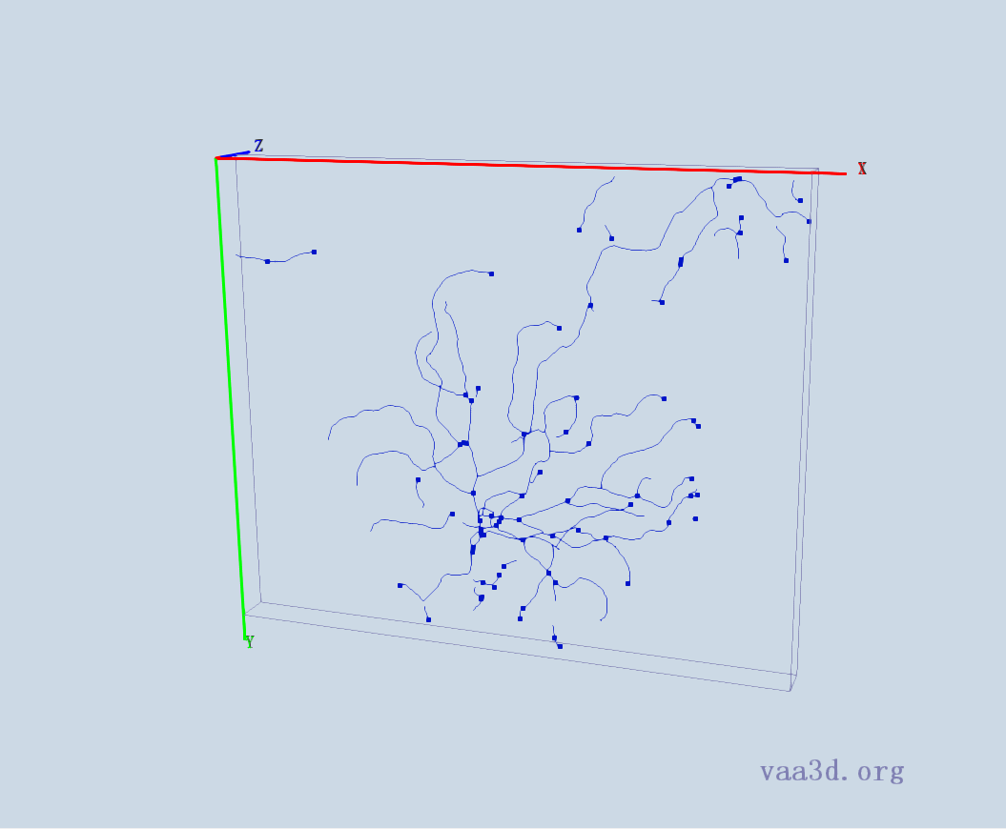
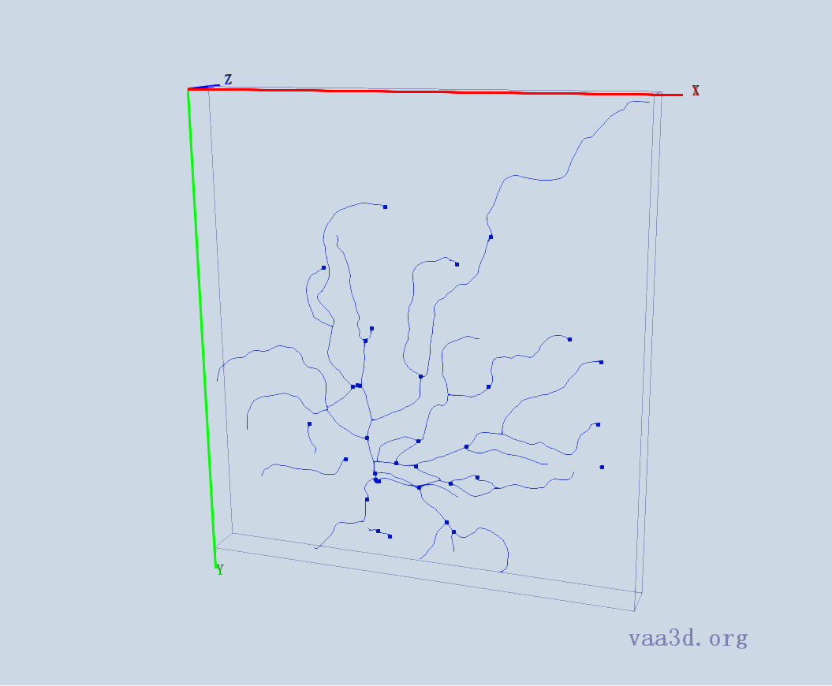
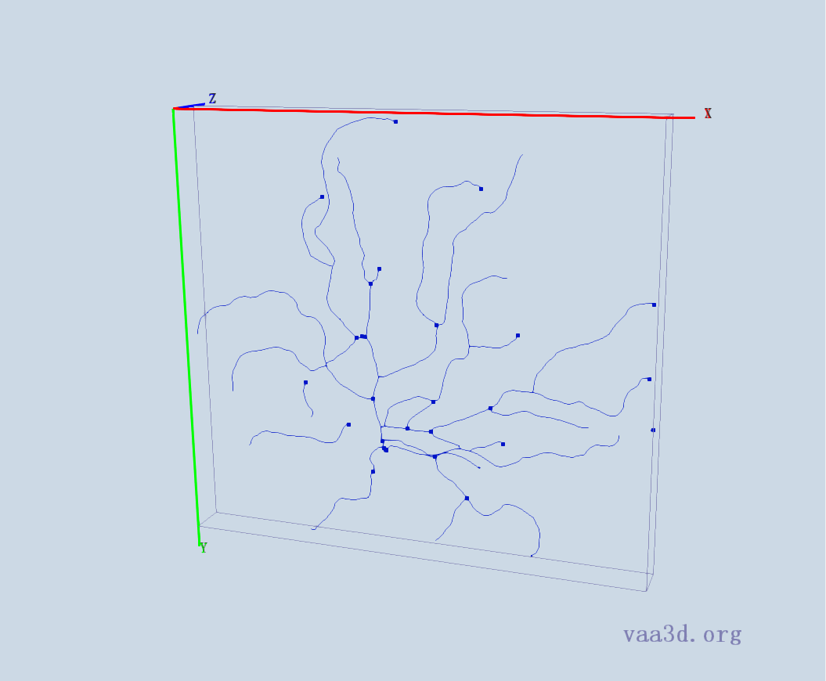
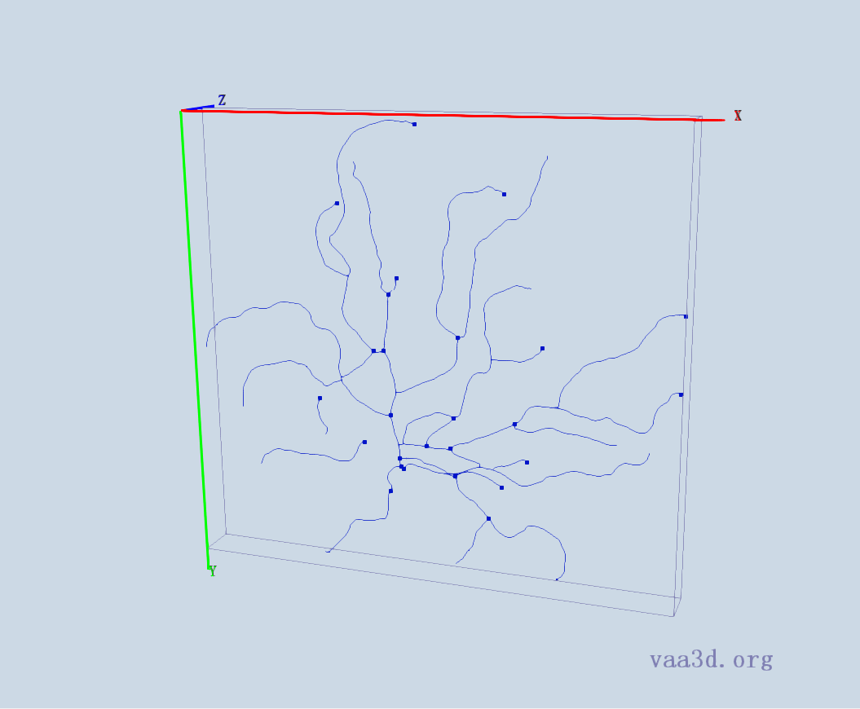

140918c8
GT
Thre=35 Thre=65 Thre=69
Thre=71 Thre=75

Slide 7
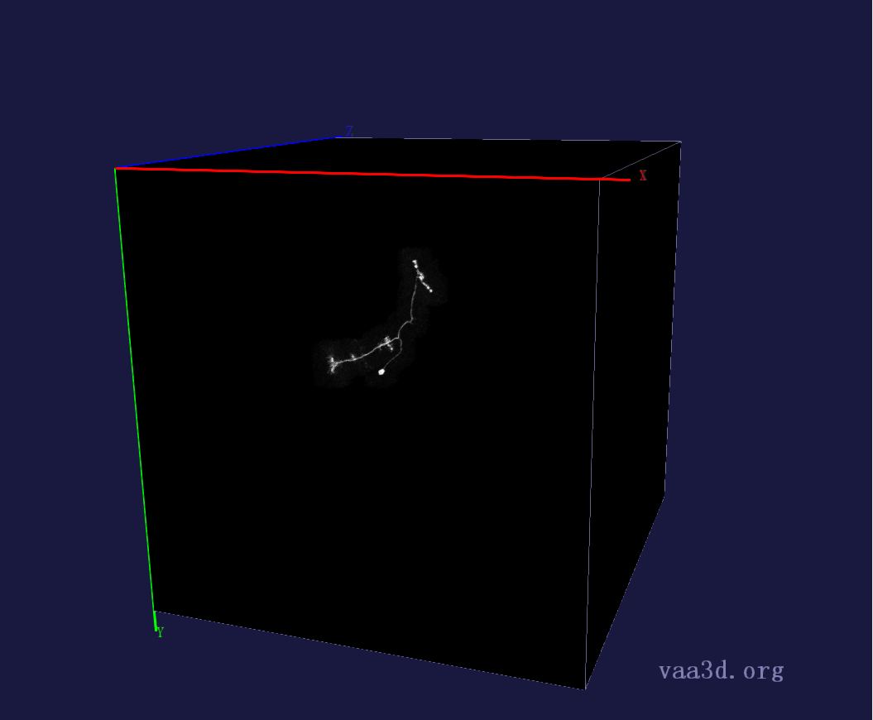
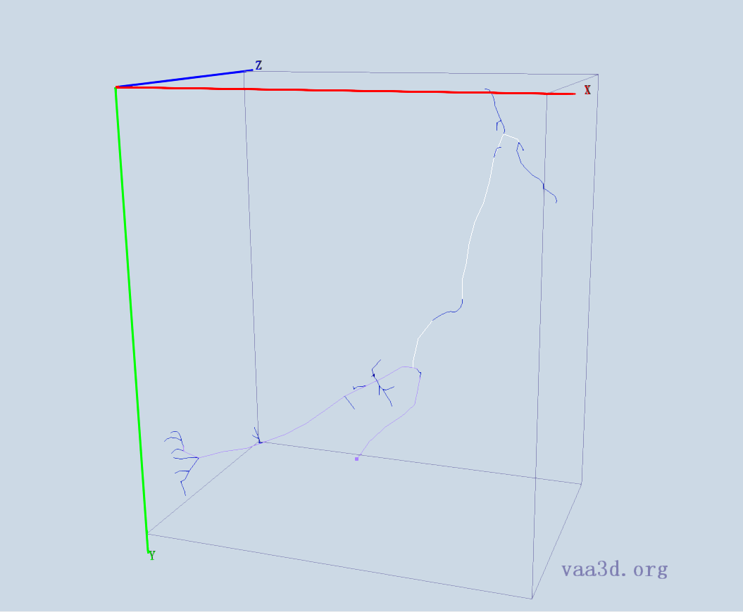
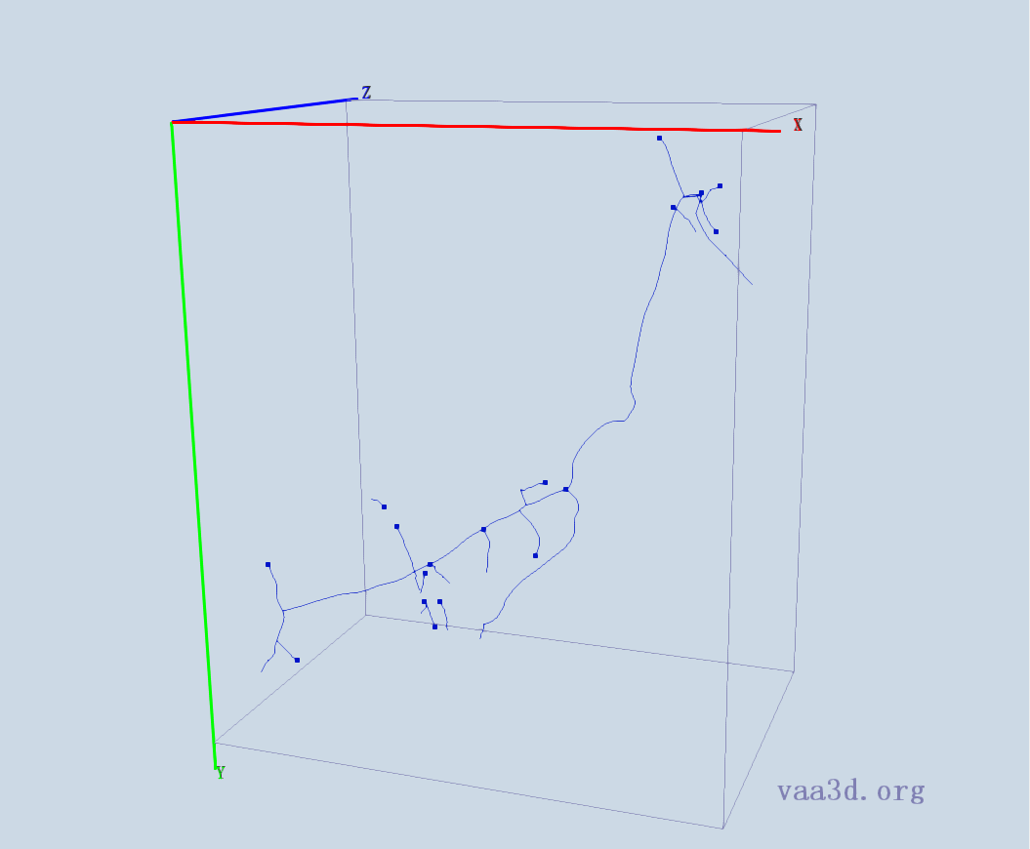
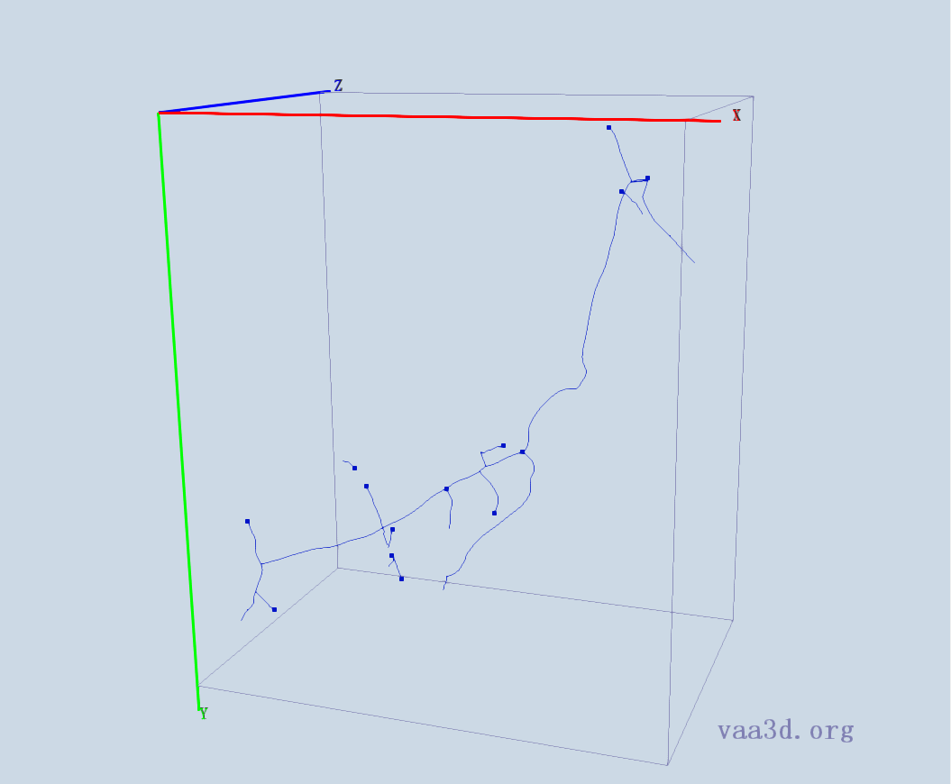
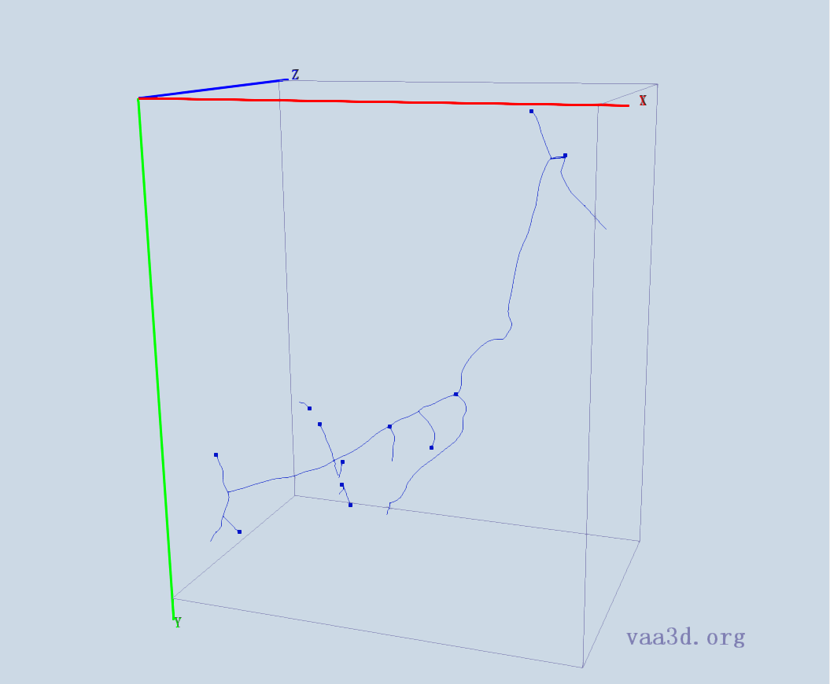
GMR_A3-
GT
Thre=11 Thre=13 Thre=17
Thre=19 Thre=20

Slide 8
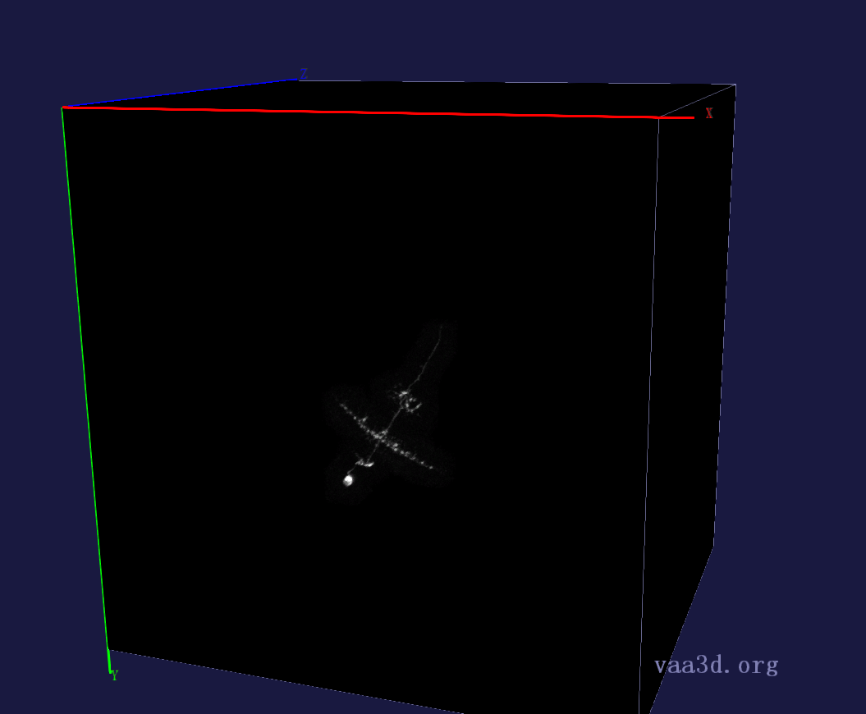
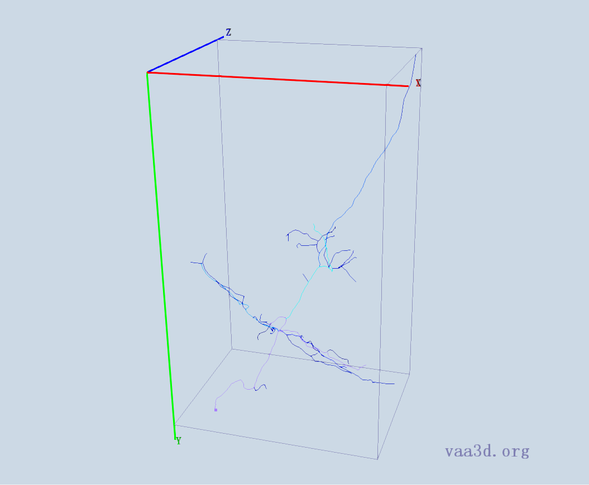
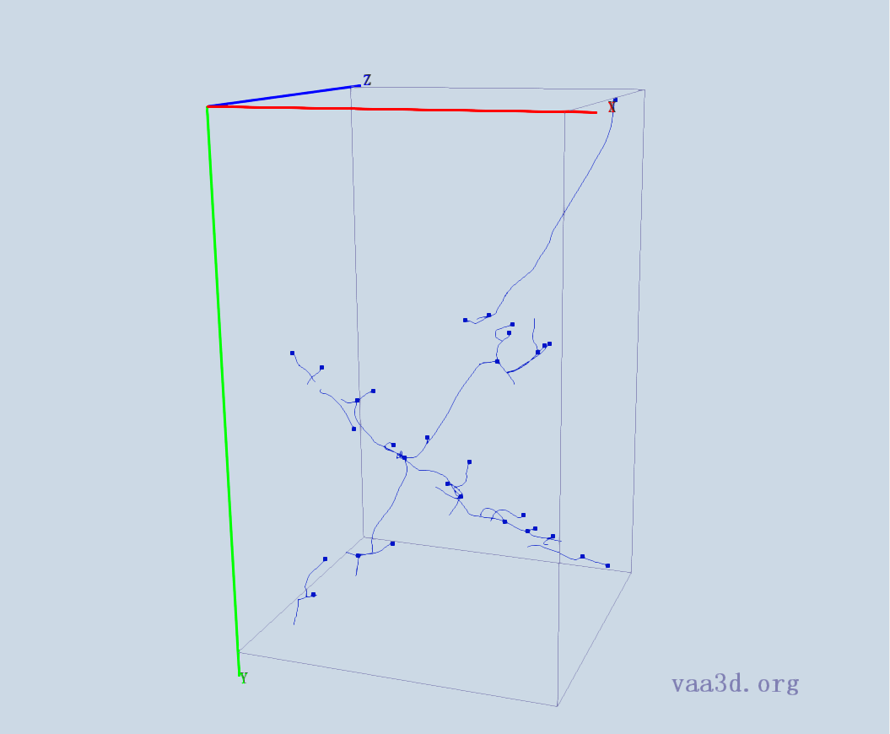



GMR_B2
GT
Thre=1 Thre=3 Thre=4
Thre=5 Thre=6

Slide 9
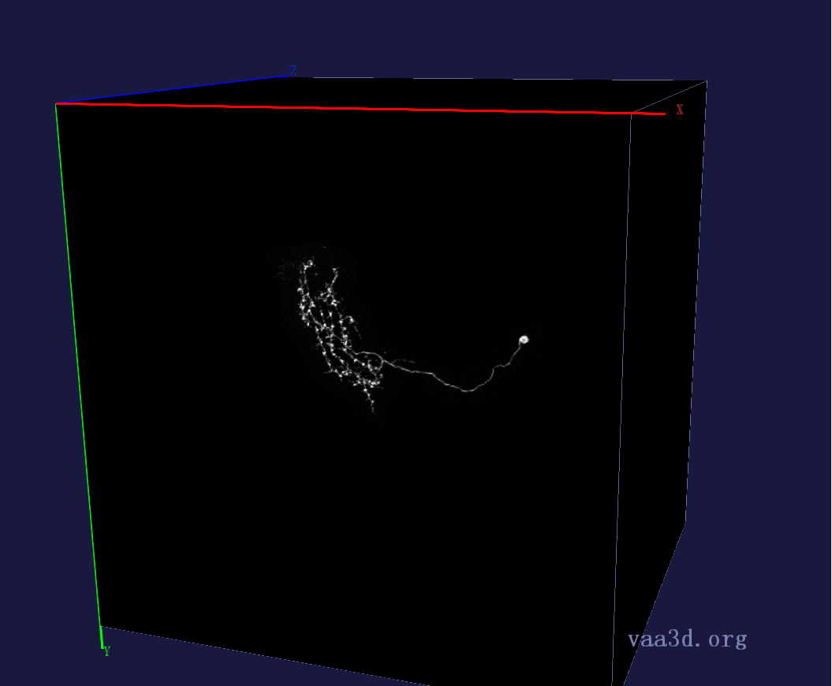
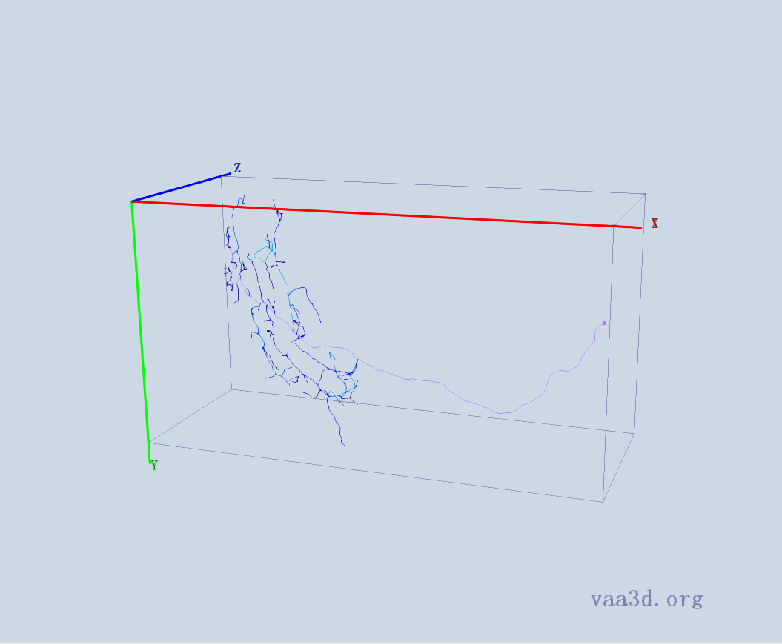


GMR_D3
GT
Thre=4 Thre=5 Thre=6
Thre=7 Thre=8

Slide 10







GMR_C1
GT
Thre=1 Thre=2 Thre=3
Thre=4 Thre=5

Slide 11







GMR_D2
GT
Thre= 3 Thre=4 Thre=5
Thre=6 Thre=7

Slide 12






GMR_E1
GT
Thre=2 Thre=3 Thre=4
Thre=5 Thre=6

Slide 13





GMR_E2
GT
Thre=2 Thre=3 Thre=4
Thre=5 Thre=6

Slide 14







GMR_E4
GT
Thre=2 Thre= 3 Thre=4
Thre=5 Thre=6

Slide 15







GMR_F3
GT
Thre=1 Thre=2 Thre=3
Thre=4 Thre=5

Slide 16







Image-7
GT
Thre=63 Thre=67 Thre=70
Thre=73 Thre=75

Slide 17







Image-10
GT
Thre=45 Thre=50 Thre=55
Thre=60 Thre=70

